Slide 1
Heroes of CSS

Slide 2
Admin Work

Slide 3
Homework Assignment
Also, at this point everyone should have access to the class repository in GitHub. https://upenn.bootcampcontent.com/upenn-bootcamp/UPENN201804FSF4-Class-Repository-FSF/tree/master/01-html-git-css/Homework/Instructions
Homework Assignment #1 is Due:
Saturday, May 12th

Slide 4
Homework Assignment
Really, work hard on this assignment! This assignment introduces you to fundamental concepts that we’ll be building the entire course-long.
Review In Class Material, especially Exercises:
https://upenn.bootcampcontent.com/upenn-bootcamp/UPENN201804FSF4-Class-Repository-FSF/tree/master/01-html-git-css
Work with your peers! It’s much better than screaming at your computer alone.
Ask Questions on Slack! Your peers, TAs, and Instructors are all here to help when they can.

Slide 5
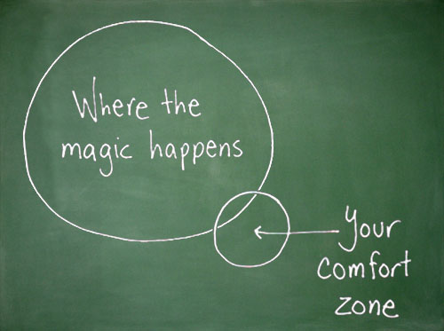
Most Important of All….
Just Submit SOMETHING (even if it seems pretty crummy)!

Slide 6
Warning!

Slide 7
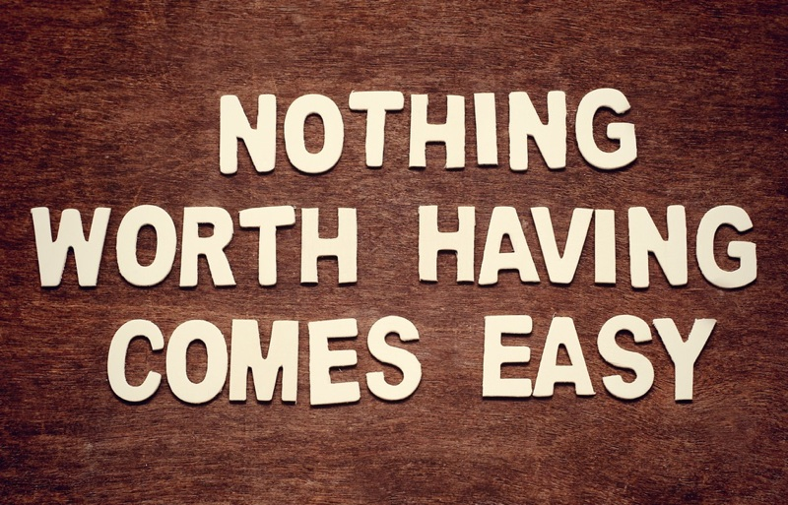
Brace Yourselves
Today is going to be a bit tough.
But trust us!
It will all look easy a few weeks from now.

Slide 8
Brace Yourselves
Don’t expect to understand EVERYTHING at once.
Today is all about getting immersed.

Slide 9
CSS

Slide 10
Critical Question
What is “CSS?”

Slide 11
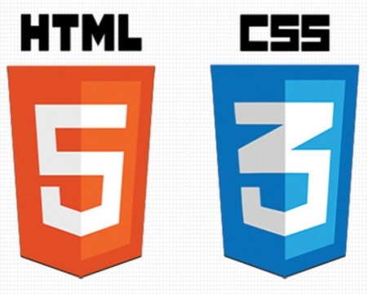

HTML / CSS Definitions (*yawn* unimportant)
HTML: Hypertext Markup Language – (Content)
CSS: Cascading Style Sheets – (Appearance)
HTML/CSS are the “languages of the web.” Together they define both the content and the aesthetics of a webpage – handling everything from the layouts, colors, fonts, and content placement. (JavaScript is the third – handling logic, animation, etc.)

Slide 12


HTML / CSS Analogy
HTML Alone
Like writing papers in “Notepad.”
Can only write unformatted text.
HTML / CSS
Like writing papers in Microsoft Word.
Can format text, page settings, alignment, etc. based on “highlighting” and menu options.

Slide 13
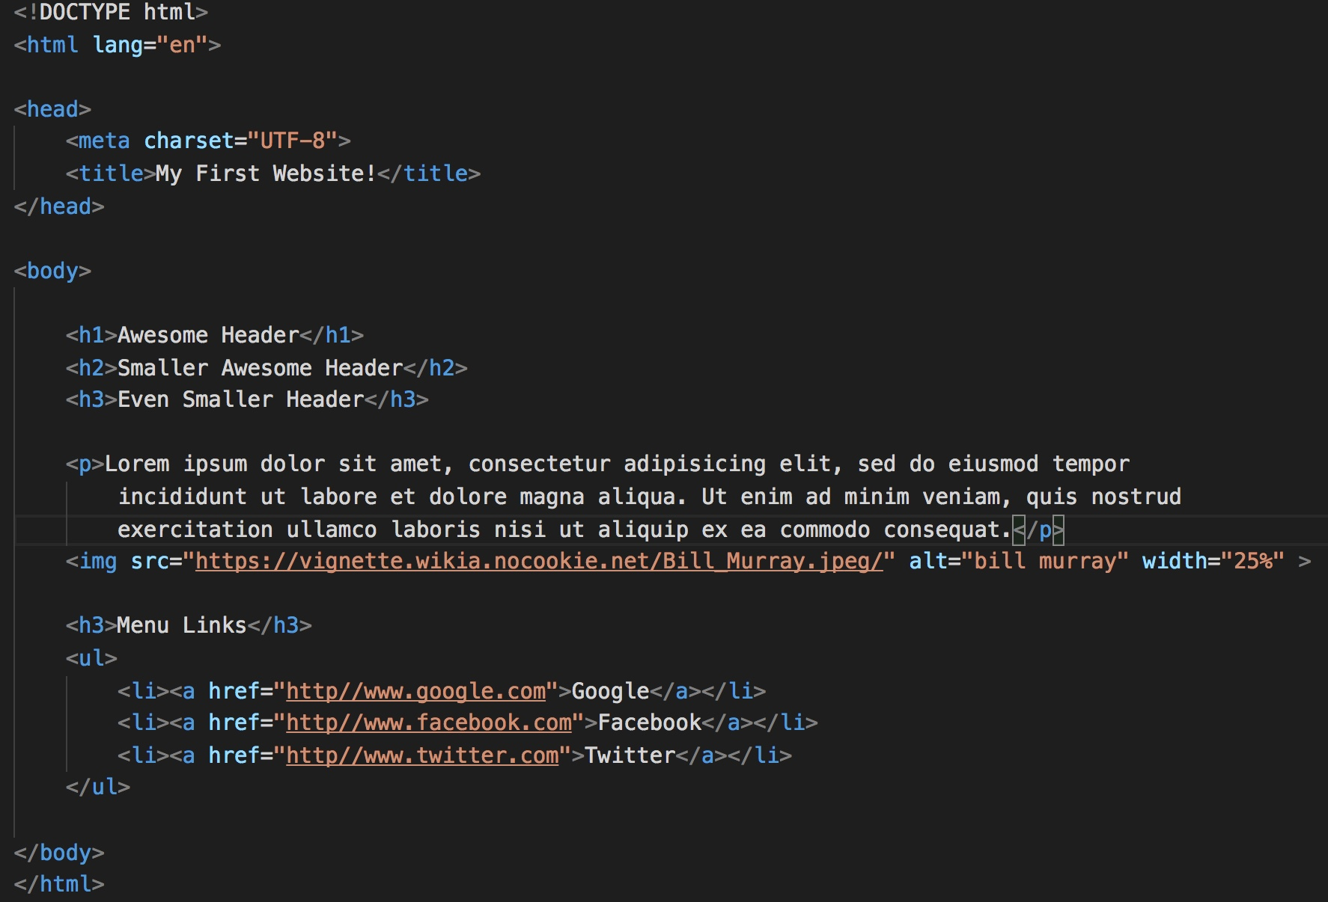
Basic HTML Page

Slide 14
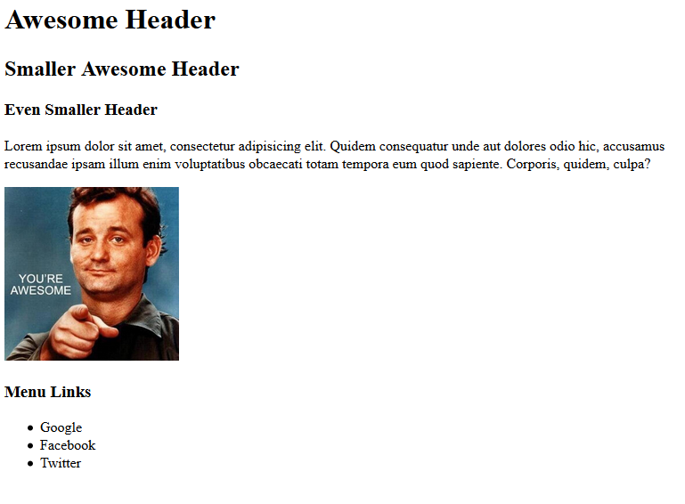
Basic HTML Page - Result

Slide 15
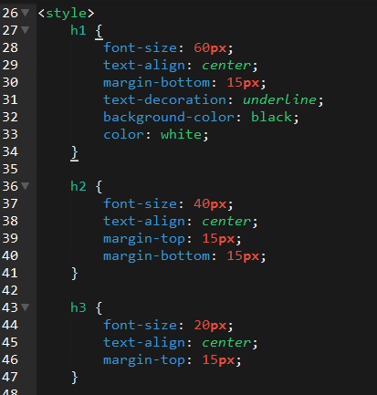
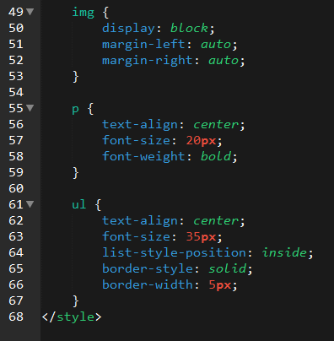
Enter CSS

Slide 16
Voila!

Slide 17
Actually, it’s more like this…

Slide 18
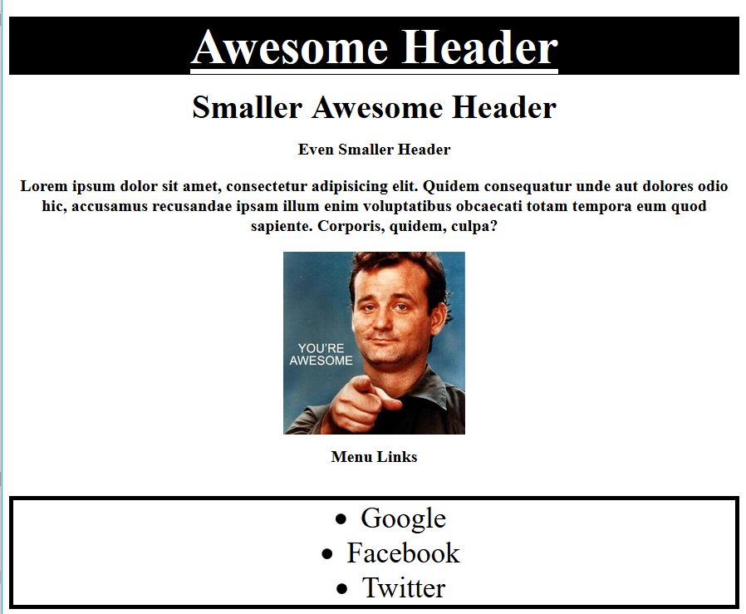
Just to get this…

Slide 19
Critical Question
How do we style HTML…
Elements?
Classes?
IDs?

Slide 20
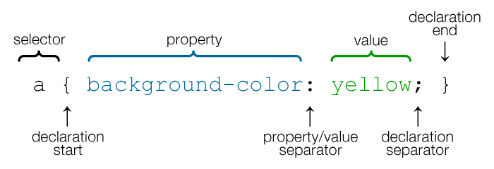
CSS Syntax
CSS works by hooking onto selectors added into HTML using classes and identifiers.
Classes use .classname, IDs use #idname, and elements use just their name.
Once hooked, we apply styles to those HTML elements using CSS.

Slide 21
CSS Syntax
CSS works by hooking onto selectors added into HTML using classes and identifiers.
Classes use .classname, IDs use #idname, and elements use just their name.
Once hooked, we apply styles to those HTML elements using CSS.

Slide 22
Key CSS Attributes
Font / Color:
color: Sets color of text.
font-size: Sets size of the font.
font-style: Sets italics.
font-weight: Sets bold.
Alignment / Spacing:
padding (top/right/bottom/left): Adds space between element and its own border.
margin (top/right/bottom/left): Adds space between element and surrounding elements.
float: Forces elements to the sides, centers, or tops.
Background:
background-color: sets background color.
background-image: sets background image.

Slide 23
Selectors
Element selector
Applies to all <p> elements
p {
background-color: blue;
}
Applies to all elements with class=“classItem"
.classItem {
background-color: orange;
}
Applies to all elements with id=“idItem"
#idItem {
background-color: green;
}
Element name
(p, a, div, span, etc)
Class Selector
Period (.) + variable name
(.myDiv, .phoneNumber, etc.)
ID Selector
Hash (#) + variable name
(#myDiv, #phoneNumber)

Slide 24
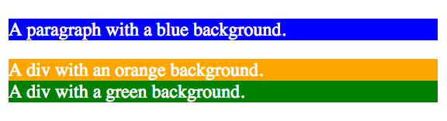
CSS Selectors
p {
background-color: blue;
}
.classItem {
background-color: orange;
}
#idItem {
background-color: green;
}
<p>
A paragraph with a blue background.
</p>
<div class=“classItem">
A div with an orange background.
</div>
<div id=“idItem">
A div with a green background.
</div>
+

Slide 25
INSTRUCTOR DEMO
Instructor: Demo
(quickexample_internalcss.html | 2-BasicCSS)

Slide 26
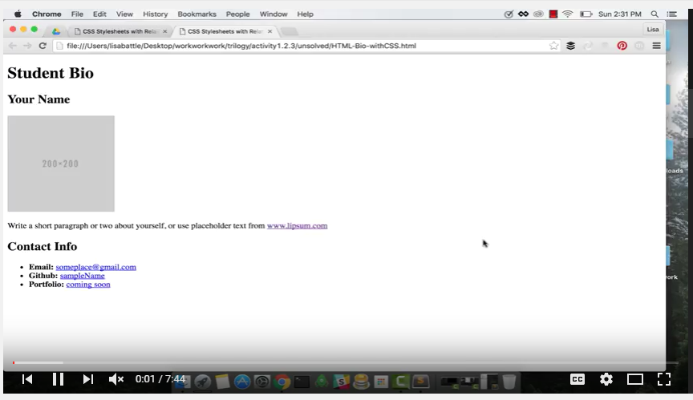
Activity with a Video Walkthrough!!!
Activity in your GitLab Folder. You can try this yourself at home and/or follow along with this great YouTube video!
https://upenn.bootcampcontent.com/upenn-bootcamp/UPENN201804FSF4-Class-Repository-FSF/tree/master/01-html-git-css/02-Day/Activities/HTML_CSS_Layout
https://www.youtube.com/watch?v=kMBinXTCrXI&list=PLgJ8UgkiorCnMLsUevoQRxH8t9bt7ne14&index=2

Slide 27
Lingering Questions
Questions so far?

Slide 28
Relative File Paths

Slide 29
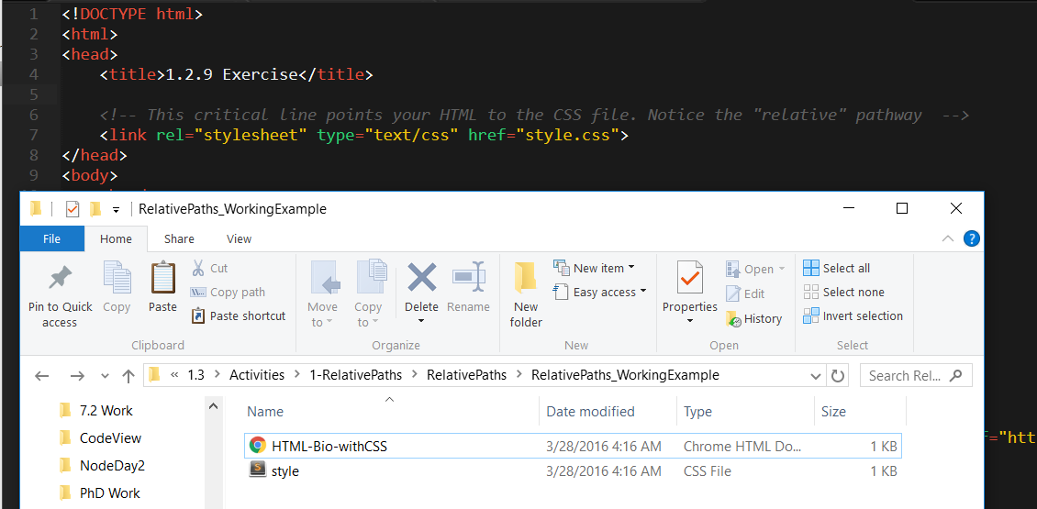
Relative File Paths
Relative file paths connect us with other files in our working directory. In this case, style.css is in the same folder as our html document.

Slide 30
Quick Demo
Instructor: Demo
(RelativePaths_DEMO | 1-RelativePaths)

Slide 31
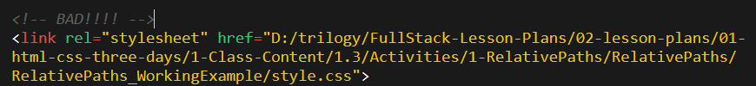

Absolutely No Absolute Paths
VERY VERY BAD
ALWAYS USE RELATIVE FILE PATHS.
If you deploy your sites without them, all of your links will fail.
The same will happen if you move your project from one folder to another.
Remember, there is no such thing as a “C:” drive on the internet.

Slide 32
> YOUR TURN!!
Activity: 1-RelativePaths| Suggested Time: 10 min
Assignment
1. Unzip the folder sent to you via Slack.
2. Edit the HTML files in all of the “RelativePaths” folders. You need to write relative paths that link the HTML documents with CSS stylesheets.
Tip: Check out the “RelativePaths_WorkingExample” folder.

Slide 33
Box Model

Slide 34
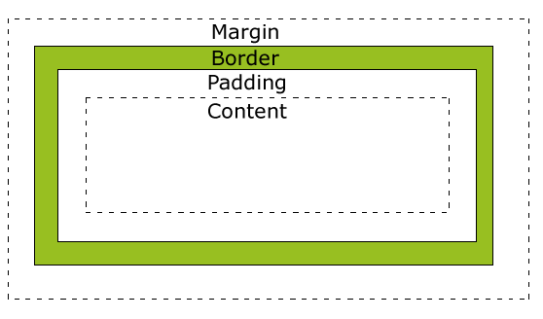
Boxes Upon Boxes
In CSS, every element rests within a series of boxes.
Each box has customizable space properties:
margin, border, and padding.
Typical spacing value: 20px 10px 10px 20px (top, right, bottom, left)

Slide 35
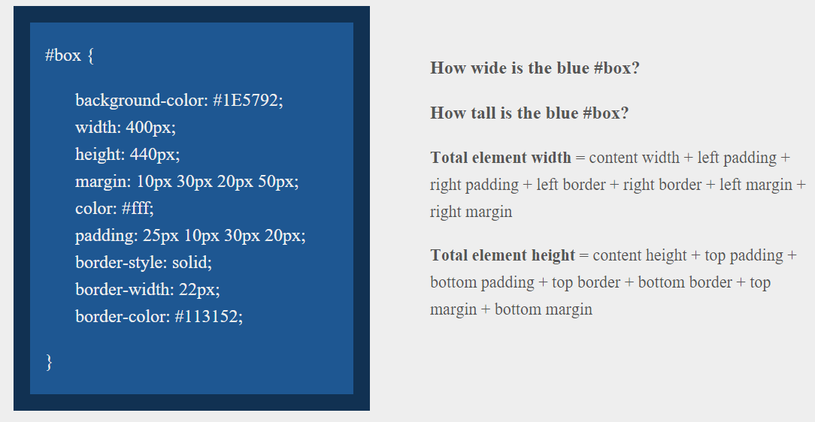
> YOUR TURN!!
Suggested Time: 10 min

Slide 36
> YOUR TURN!!
Answer
Width: 474 px (no margin), 554 px (with margin)
Height: 539 px (no margin), 569 px (with margin)

Slide 37
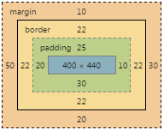
> YOUR TURN!!
Answer
Width: 474 px (no margin), 554 px (with margin)
Height: 539 px (no margin), 569 px (with margin)

Slide 38
We Be Floatin’

Slide 39
Take a Facebook Break…
Warning!
These next topics are fairly “tricky”… but VERY IMPORTANT.
Time to channel that inner genius.

Slide 40
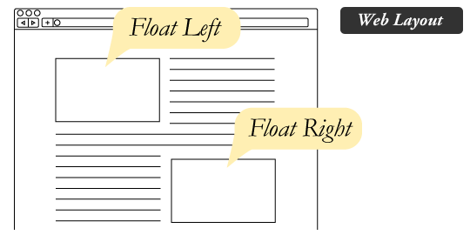
The Concept of “Flow”
By default, every HTML element displayed in the browser is governed by a concept called flow.
This means that HTML elements force their adjacent elements to flow around them.

Slide 41
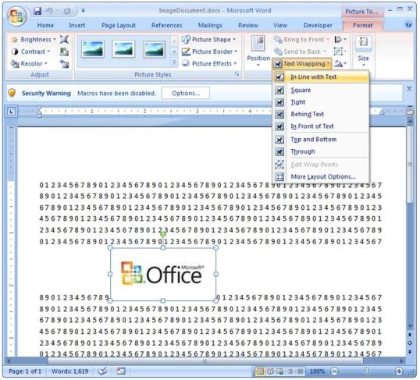
Flow Analogy to MS Word
This concept of “flow” is very similar to the wrap-text options you may be familiar with in Microsoft Word.
Just as in MS Word, you can have images in-line with text, on-top of text, etc.

Slide 42
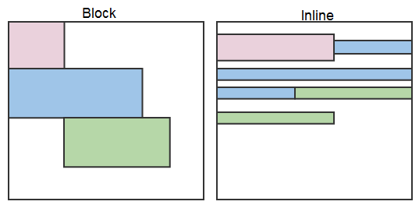
Block Elements
By default, web clients render many HTML elements as block elements. Paragraphs, headers, divs and more receive this treatment.
A block element will take up an entire line of space—unless you intervene with CSS properties.

Slide 43
Block Elements vs. Inline Elements
Now contrast the block elements with inline elements.
By using float CSS properties, we can command our website to display multiple HTML elements adjacently.

Slide 44
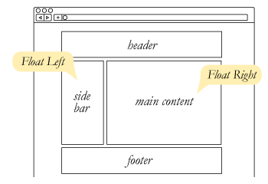
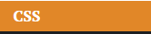
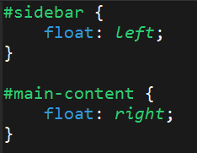
Floating
To transform these block elements into inline elements, we use a CSS property called float.
Floats are necessary for building web layouts.

Slide 45
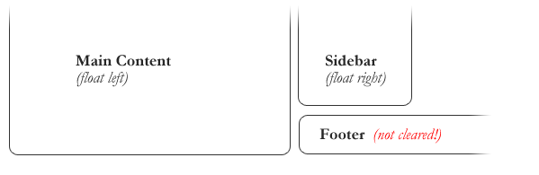
Clearing the Float
Floats often get in the way of our layouts.
Sometimes we don’t want to give each element the “inline” treatment.

Slide 46
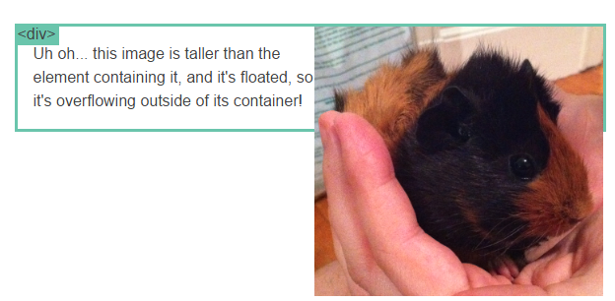
Clearfix Hack
Sometimes when elements don’t match up in size, we get situations like the above…

Slide 47
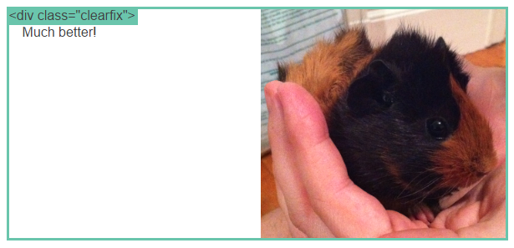
Clearfix Hack
We can get around this by using “the clearfix hack.”

Slide 48
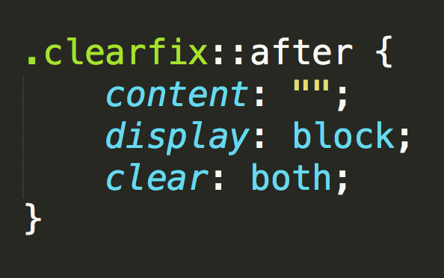
Clearfix Hack
::after is what we call a pseudo-element. We use it to style specific parts of an element.
This will add an HTML element, hidden from view, after the content of the “.clearfix” element. This clears the float.

Slide 49
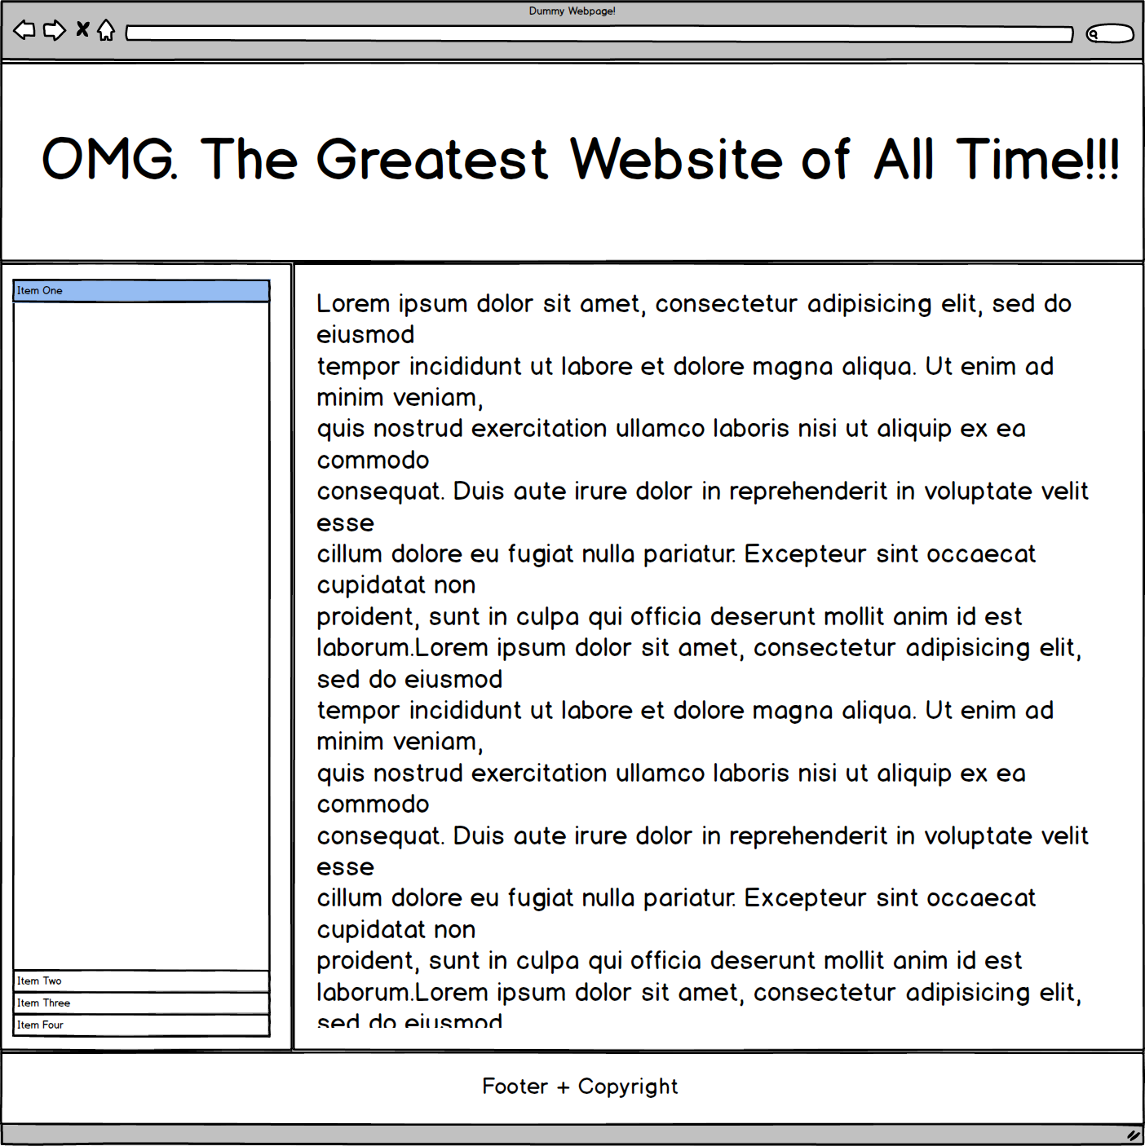
Quick Demo!

Slide 50
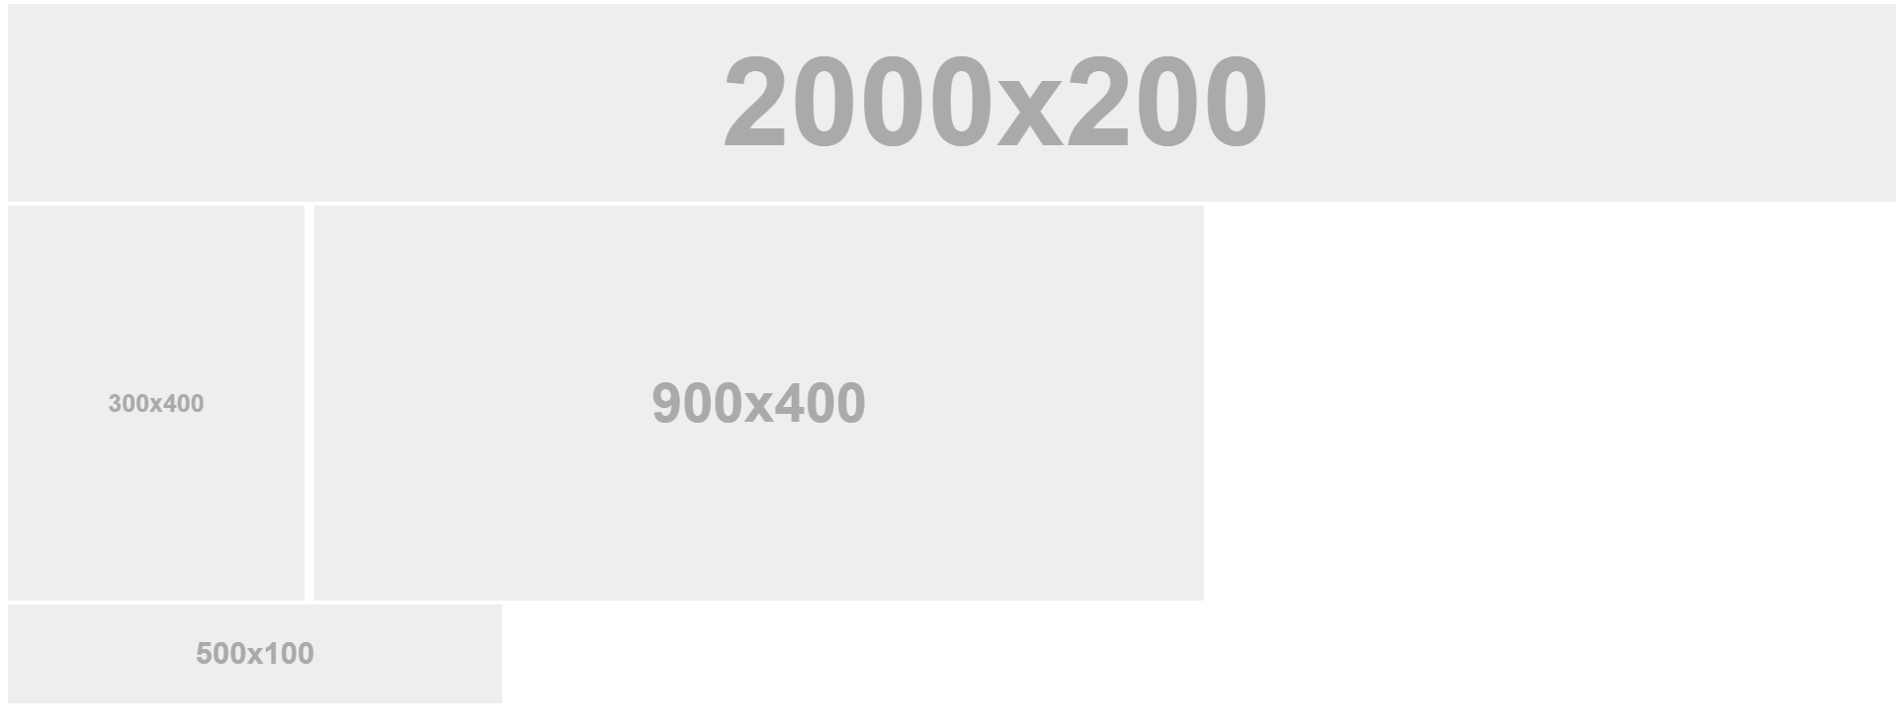
Quick Demo!

Slide 51
Quick Demo
Instructor: Demo
(2-FloatExamples)

Slide 52

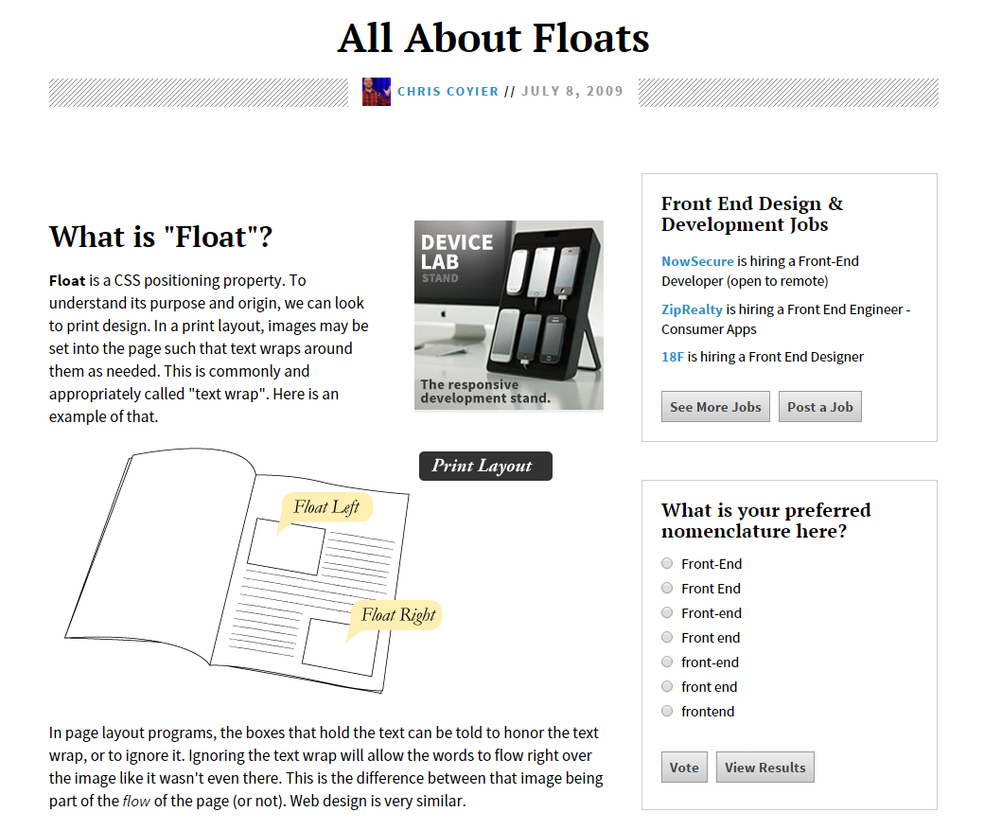
Fantastic Guide on Floats ****
To all serious front-end developers (this is a necessary read): https://css-tricks.com/all-about-floats/

Slide 53
> YOUR TURN!!
Activity: 3-FloatLayout-Activity | Suggested Time: 30 min
Assignment
In this activity, you’ll flex your newfound floating skills by creating a conceptual layout. Eyeball the design to your best ability.
Check your Slack for more instructions.

Slide 54
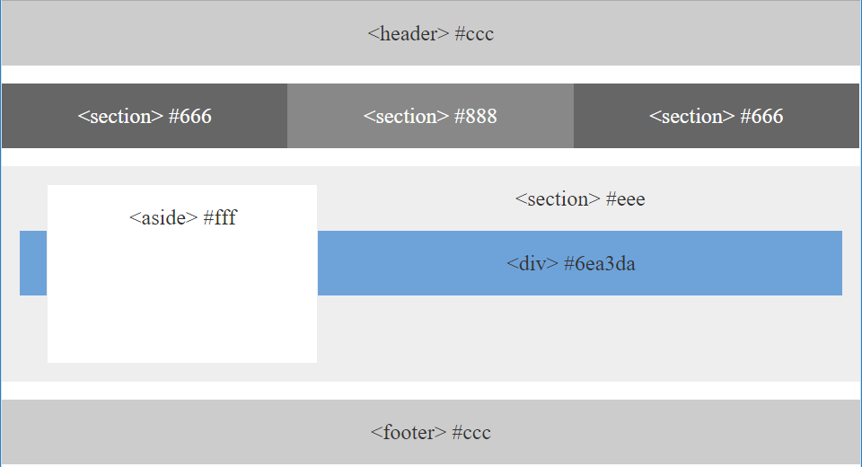
> YOUR TURN!!

Slide 55

Good work!
Your brain may rest now…

Slide 56
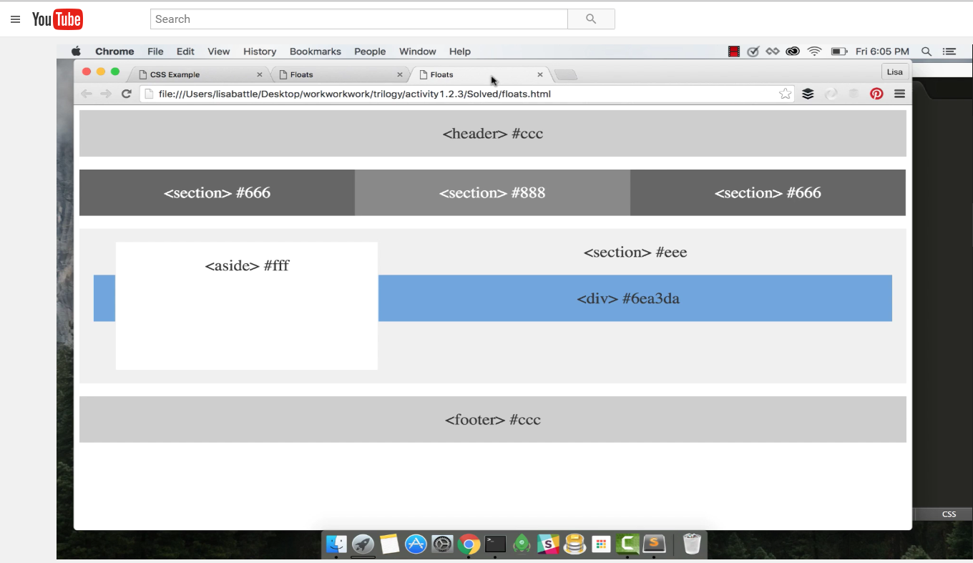
Video Walkthrough! (Highly, HIGHLY Recommend!!!)
Video Link: https://youtu.be/0lpxKw6E90Y

Slide 57
BREAK!

Slide 58
CSS Positioning

Slide 59
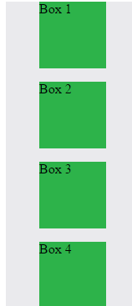
Position: Static (Default)
Four boxes placed statically (default)

Slide 60
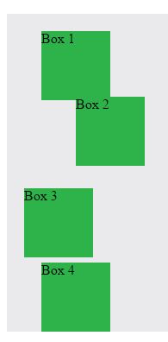
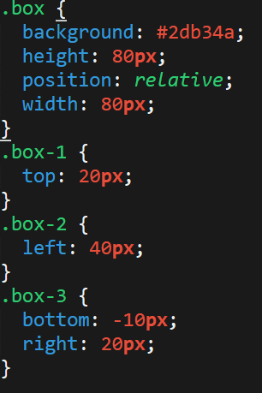
Position: Relative
Switching the boxes to relative will nudge the boxes in relation to their “original” location.

Slide 61
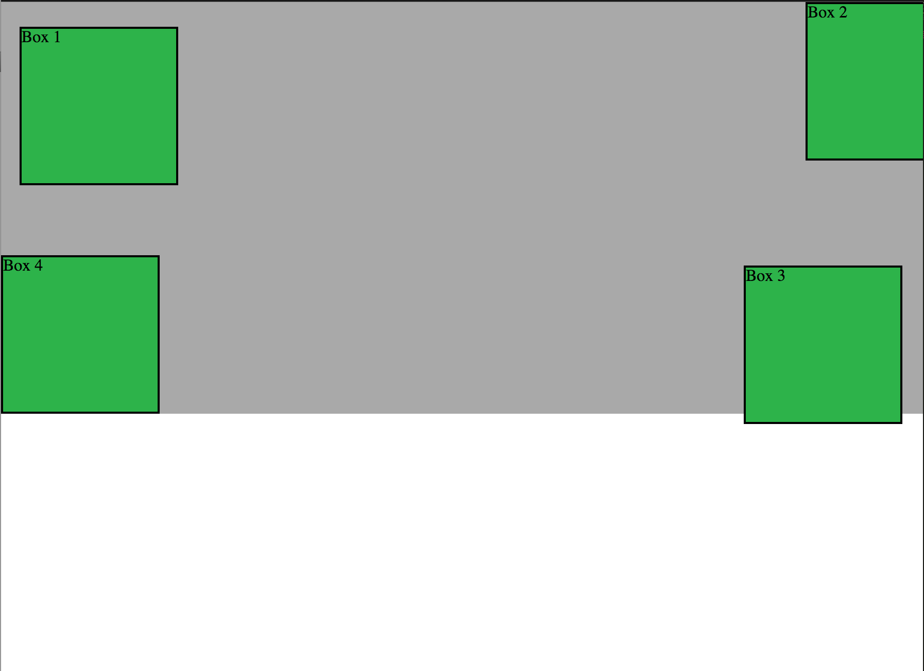
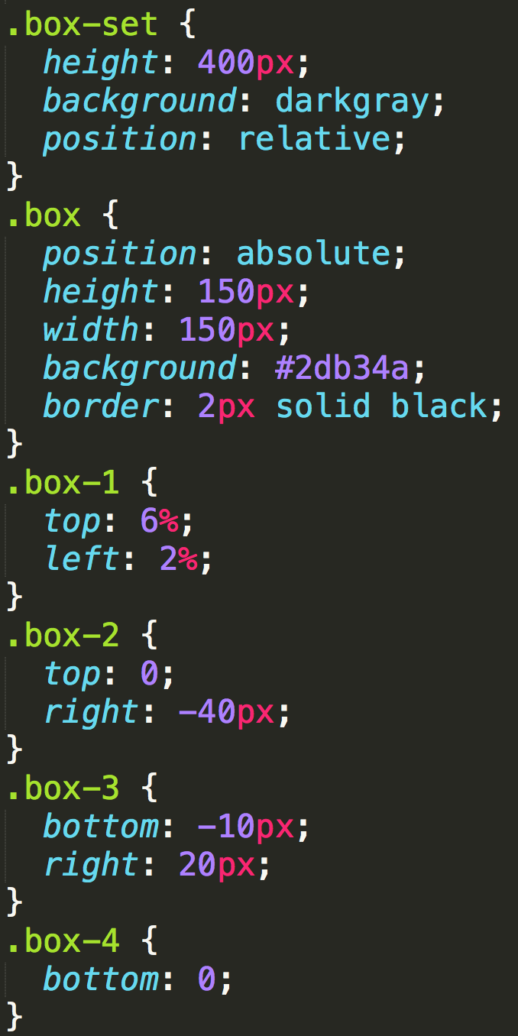
Position: Absolute
Positioned relative to nearest positioned ancestor
Notes:
An element that is positioned absolutely is taken out of the flow and thus takes up no space when placing other elements.
The absolutely positioned element is positioned relative to nearest positioned ancestor (non-static).
If a positioned ancestor doesn't exist, the initial container (body) is used.

Slide 62
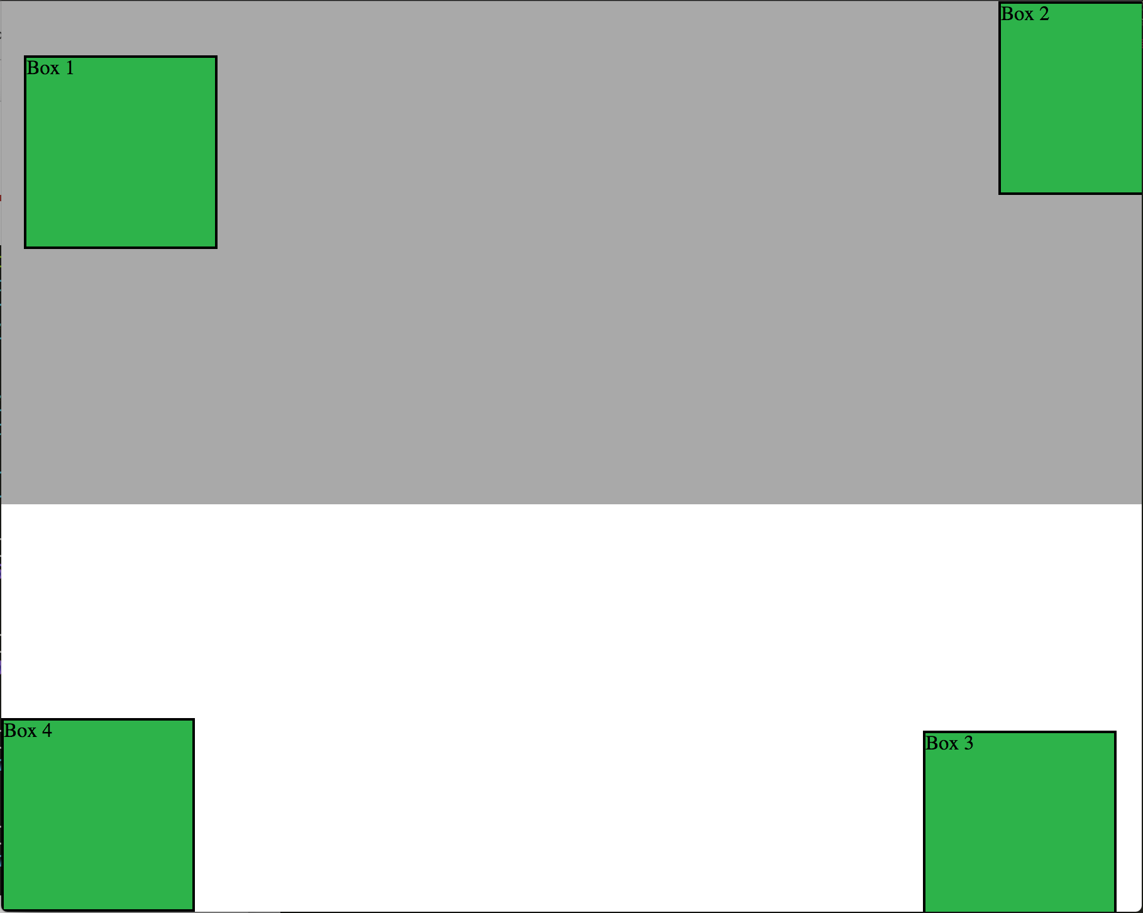
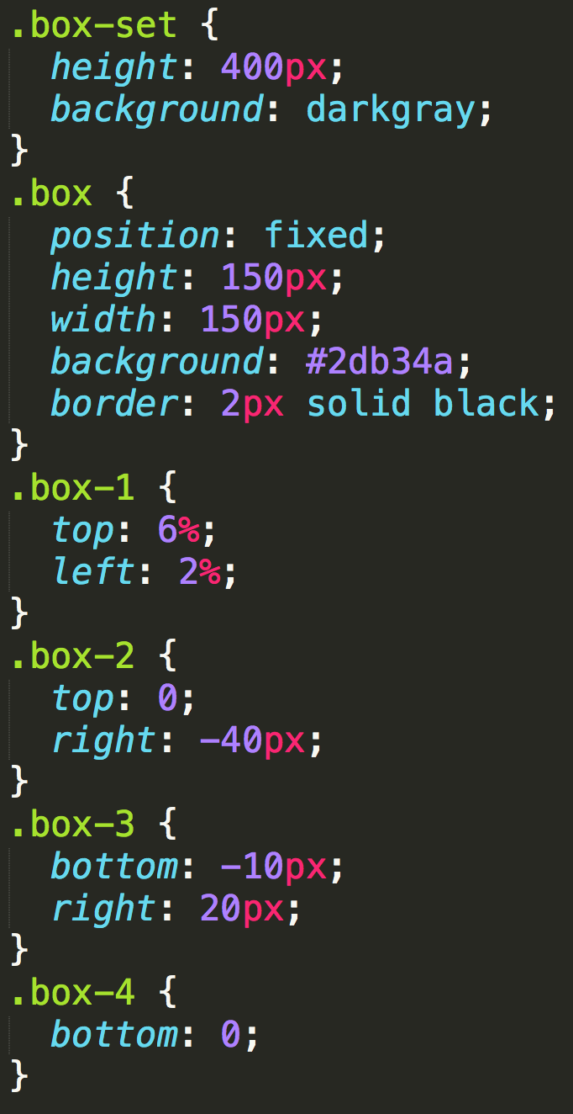
Position: Fixed
Position with exact coordinates to the browser window

Slide 63
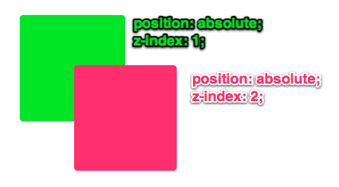
Layering with Z-Index
Z-Index allows you to layer elements on top of each other when they’re positioned.
Notes:
The elements must be positioned (any position other than static)

Slide 64
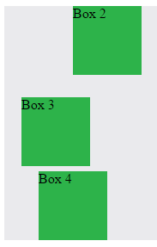
Hiding Things
“Display: none” allows us to hide elements from view.
This will become useful in later sections, when we’ll be hiding and revealing specific HTML elements of our choice.

Slide 65
Quick Demo
Instructor: Demo
(5-CSS_PositionedLayout)

Slide 66
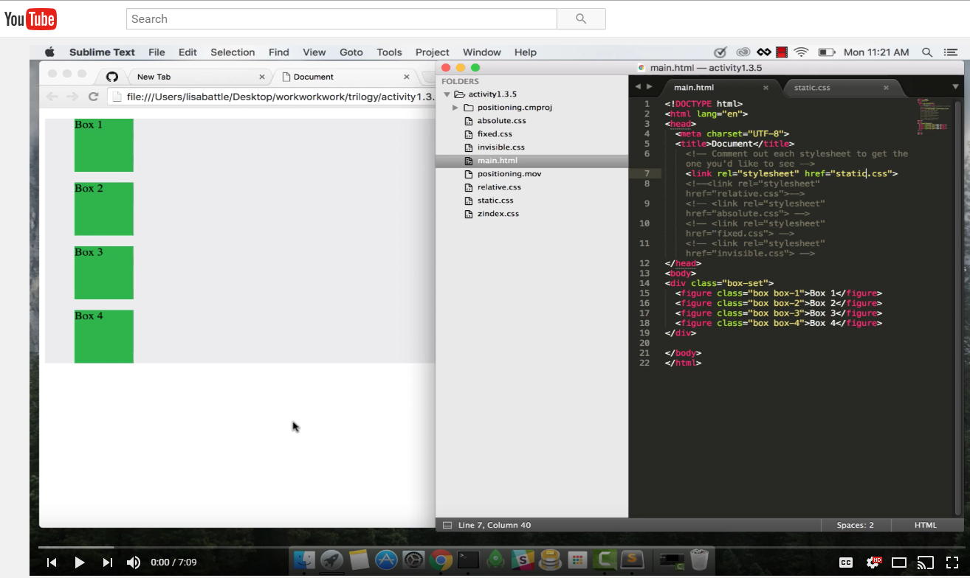
Video Walkthrough!
Video Link: https://youtu.be/sHfJn0jqBro

Slide 67
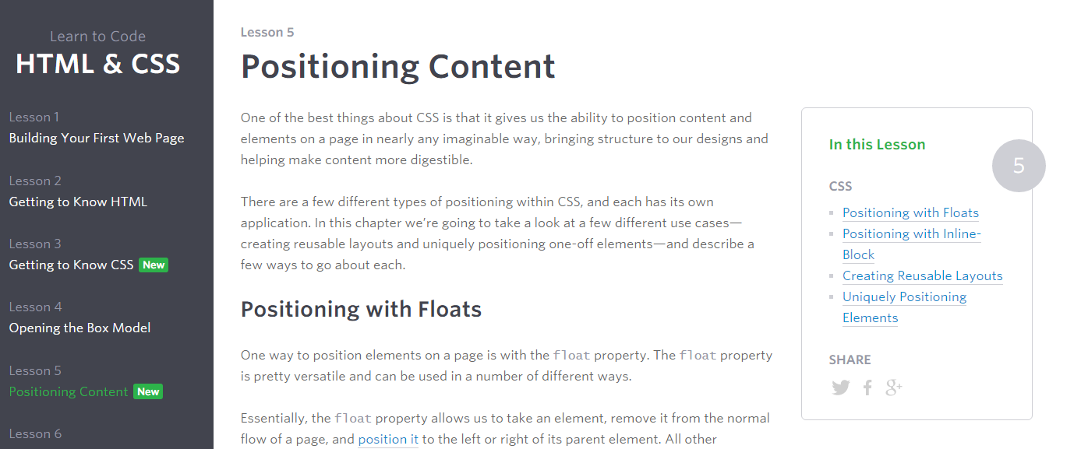
Great Resource
Another great read for front-end developers: http://learn.shayhowe.com/html-css/positioning-content/

Slide 68
> YOUR TURN!!
6-CSS_Positioned_Activity | Suggested Time: 30 min
Assignment
In this activity, you’ll flex your newfound positioning skills by creating another conceptual layout. Eyeball the design to your best ability.
Check your Slack for additional instructions.

Slide 69
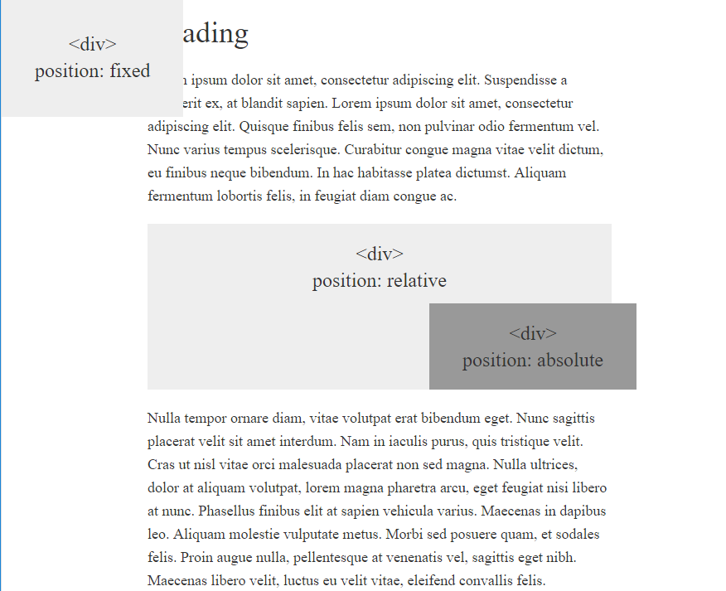
> YOUR TURN!!

Slide 70
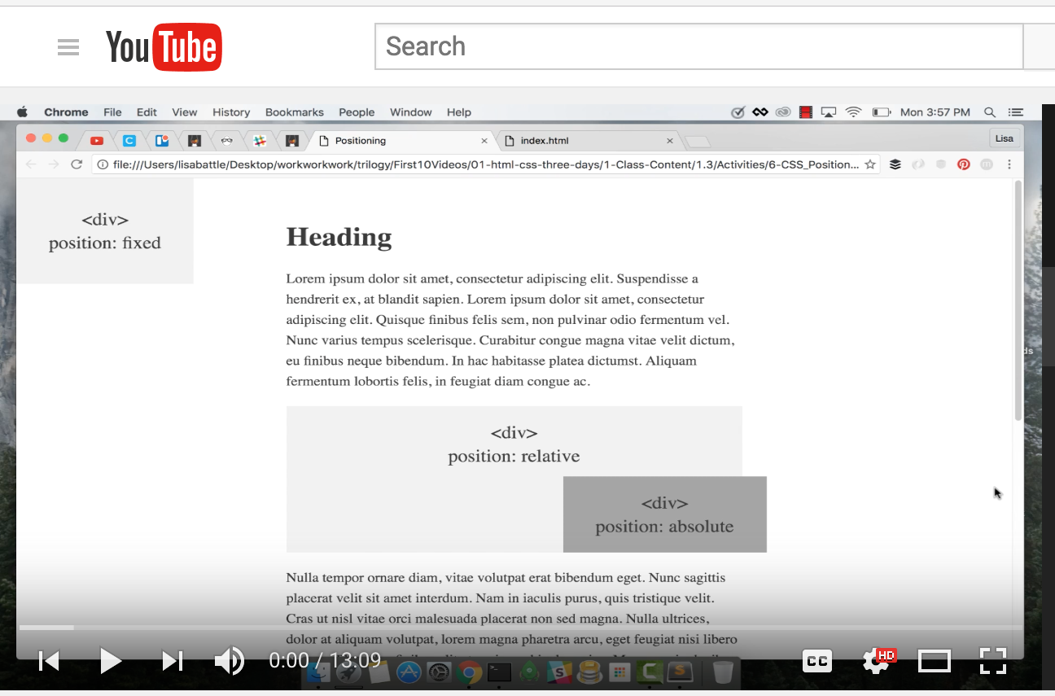
Video Walkthrough!
Video Link: https://youtu.be/yWXgnQaWSW0

Slide 71
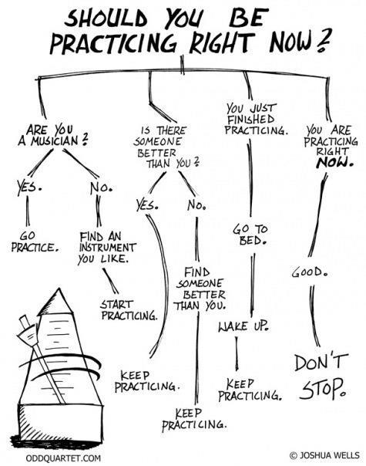
Advice
Re-do this at home. We designed this exercise
to firm up your HTML/CSS skills.
REMEMBER:
The best way to learn
web development
is to PRACTICE!

Slide 72
Chrome Inspector

Slide 73
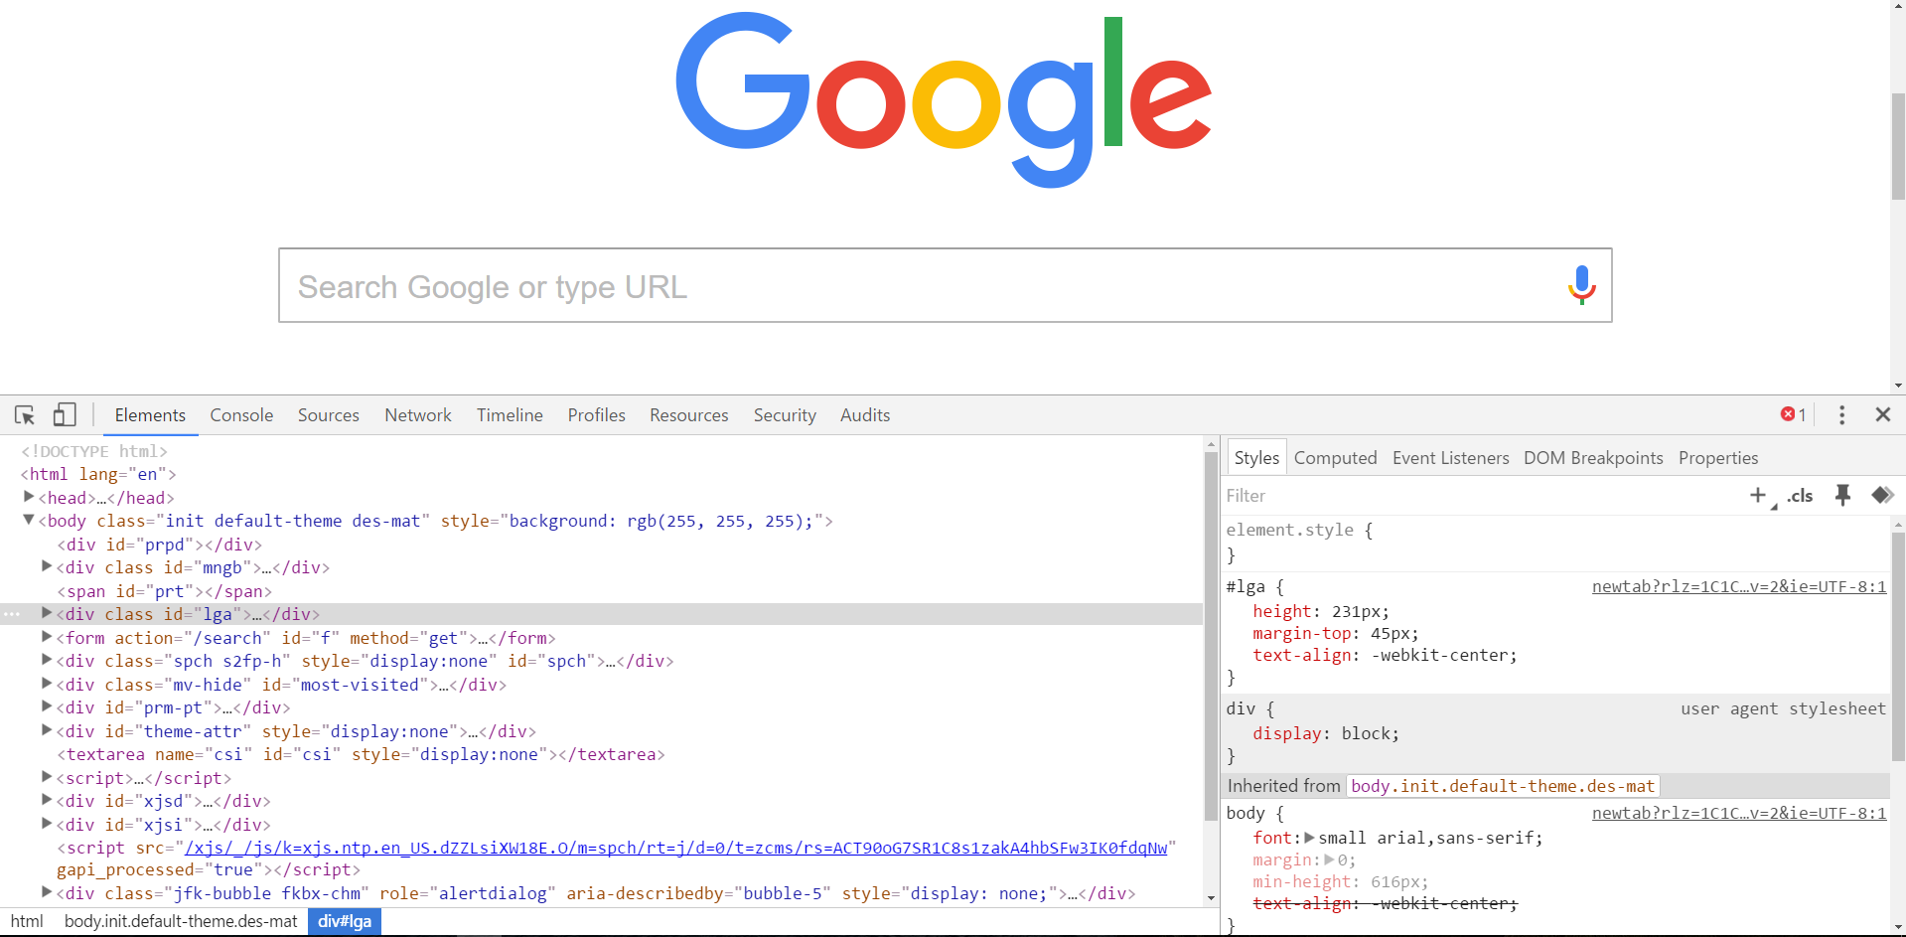
Chrome Inspector is Your Friend
To access chrome inspector, right click on a page. Then hit “Inspect.”
It will allow you to inspect the HTML, CSS and more!

Slide 74
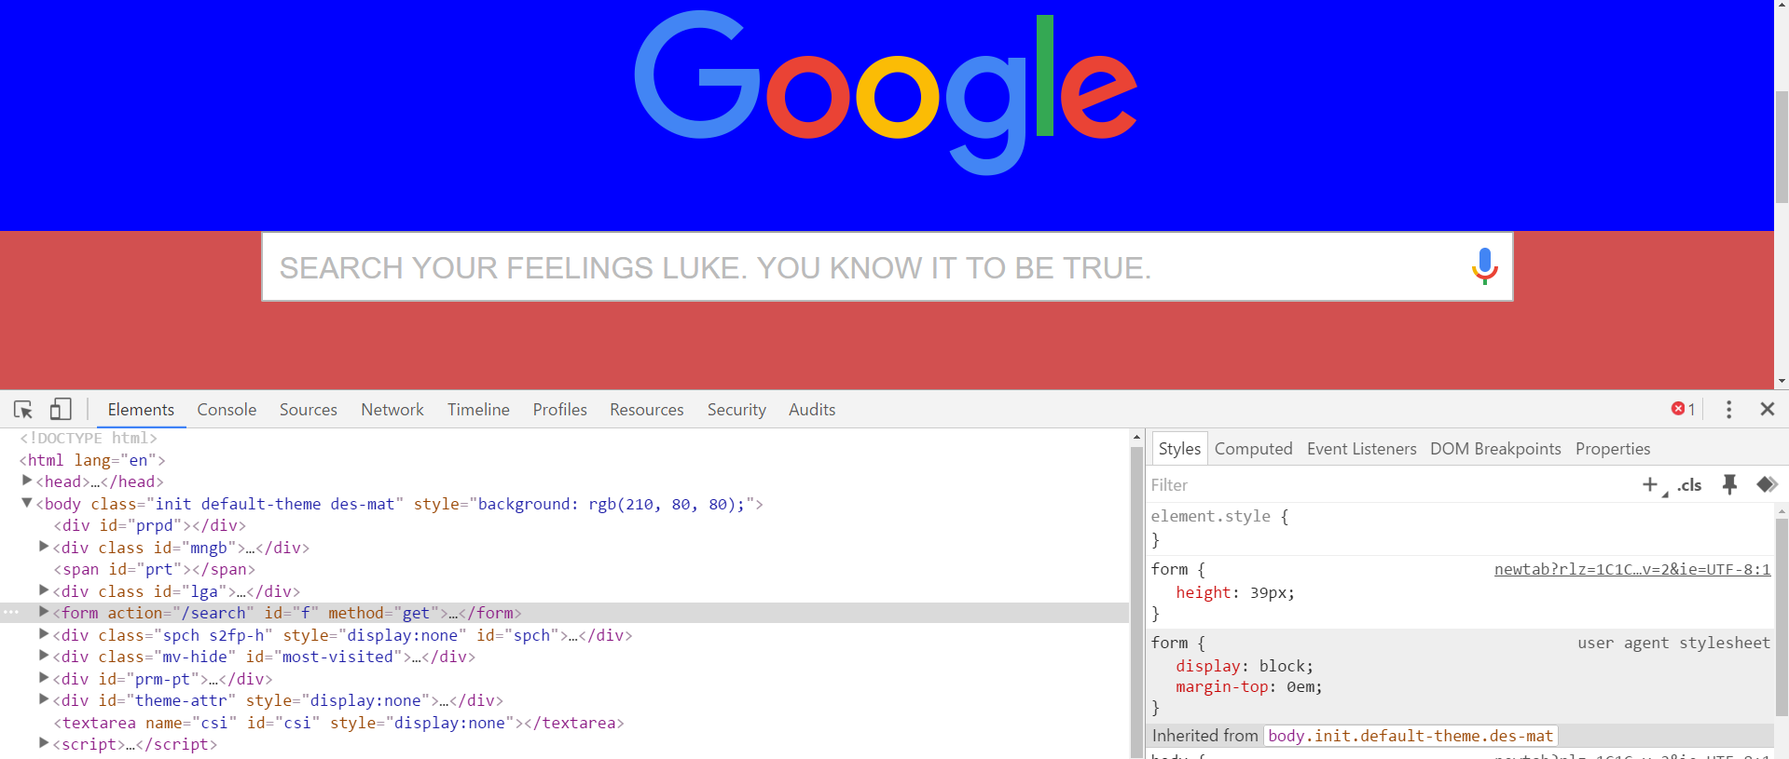
Chrome Inspector is Your Friend
You can even edit the HTML/CSS of a webpage and instantly view your changes in the browser!
This works on any website, whether yours or not.

Slide 75
Next Class!
We’ll be coming back to this
in our next class.

Slide 76
Recap + Reassurances

Slide 77


Slide 78
Questions?

Slide 79
EXTRA MATERIAL

Slide 80
> YOUR TURN!!
Assignment
Take a website you commonly visit (Amazon, Google, Huff Po, etc.) and heavily modify it with Google Developer Tools.
You have 15 minutes to test Chrome Inspector. Try modifying:
Content (change words).
Colors.
Spacing.
Any other CSS style rules.
When you’re done, send a screenshot to your class’s Slack.

Slide 81
CSS Resets

Slide 82
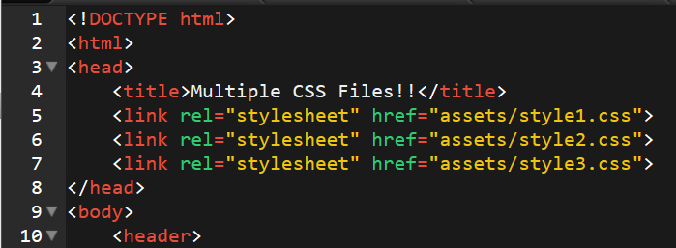
Loading Multiple CSS Files ***(Very Important!!!)***
We can link our documents to more than one stylesheet at a time—one of the most powerful features of CSS/HTML.
By tapping into different stylesheets simultaneously, we can create complex layouts with plenty of design rules.
Just remember: the loading order matters!!!

Slide 83
What Browser?
By a show of hands…
Which browser do you use?

Slide 84

Battle of the Browsers
Under the hood, web browsers often render webpages differently than their competition.
These disparities could mean HTML/CSS displaying differently in each web client.
Because of these potential divergences, web developers need to make their websites cross-browser compatible.

Slide 85
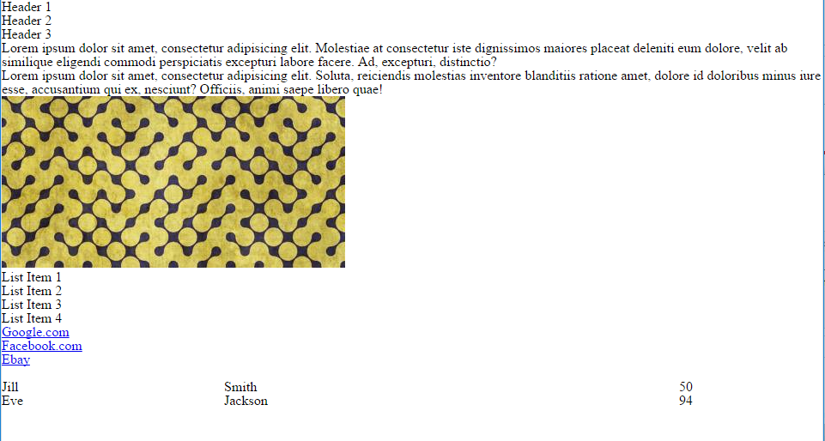
Reset.css (or Normalize.css)
Reset.css will “reset” all browser-specific CSS. This means your site will appear the same in all browsers.
However, you will have to re-style everything yourself.

Slide 86
Why CSS Resets Matter
It’s important for creating browser-compatible websites.
It’s an example of using someone else’s CSS in your website!!!
It’s a common Front-End Developer Interview question.

Slide 87
> YOUR TURN!!
Assignment
Follow the instructions given via Slack to incorporate a reset.css file in a basic HTML file.
Note the impact of the reset file makes after you include it.

